Slide 1
Project Management

Slide 2
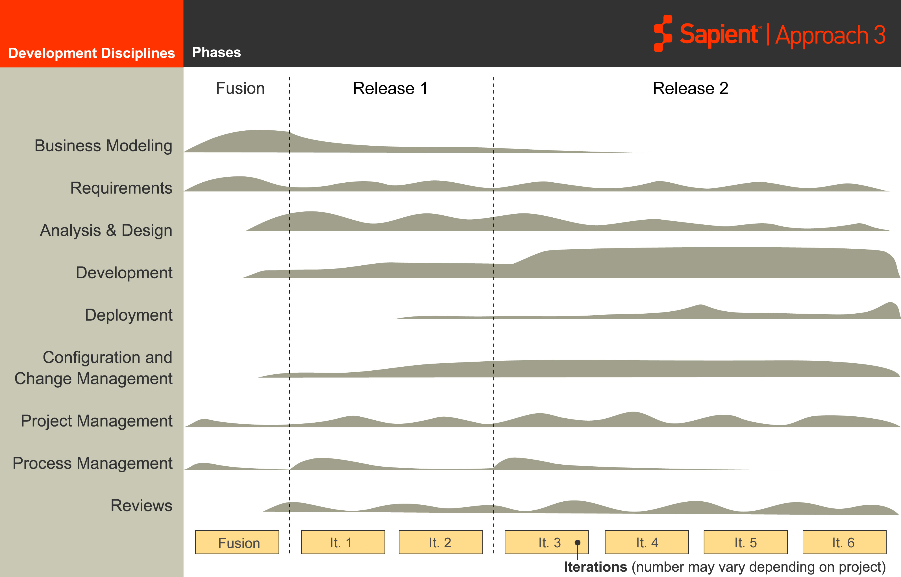
S|A 3 Project Life Cycle
Sapient|Approach 3
Disciplines
Fusion
EAR
Release 2
It 1
It 2
It 3
It 4
It 5
It 6
Project Management occurs throughout the project life cycle

Slide 3
Project Management Activities
Analysis & Design
Configuration Management
Estimate
Project Management
Development
Plan
Project Management
Monitor & Adapt
Requirements
Reviews

Slide 4
Estimate

Slide 5
Estimate Activities
Estimate Size
Estimate Effort
Estimate
Estimate Cost
Project Management
Plan
Monitor & Adapt

Slide 6


Estimate Effort
Purpose:
  Balance the constraints of project size, effort, schedule and cost to create a solid estimate
Objective:
  Develop a functional work breakdown structure that describes the activities required to complete the project
  Determine level of effort required to fulfill project objectives
  Determine staffing model required to fulfill project objectives
Activities:
  Create set of prioritized stories
  Estimate each story using the Wide-band modified Delphi technique
  Assign stories to an iteration, OR
  Assign staffing model then assign stories to iteration
  Add risks and Add-ins
  Reconcile staffing plan (without Oversight) with total LOE
Mandatory Artefact:
  Estimation Tool

Slide 7
Wide-Band Modified Delphi Estimation Technique
2-3 team members estimate stories independently
For stories where estimates are similar, estimates are incorporated without further discussion/analysis
For stories where estimates are vastly different, further analysis and discussion is done until team comes to consensus

Slide 8
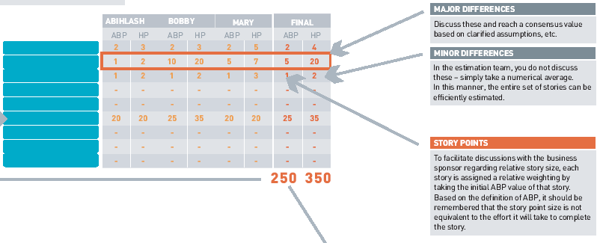


Wide-Band Modified Delphi Estimation Technique
Notes:
Speaker notes:
Key point to note about the WBMD technique is that estimates are done INDEPENDENTLY by 3 people, who are experienced enough to do an estimate. The goal of the WBMD technique is not to break down each story to a granular level of detail, but to do a holistic estimate of the story based no experience and gut-feel. Each person participating in the estimate, should go through the list quickly and swiftly, coming up with a number.
TO automate this process alittle, some teams have put together a quick and dirty excel that allows indiv to input the ABP and HP, and then the excel highlights those stories where the differences in the 3 estimates are higher than a defined treshhold.
When the estimates are radically different, at a very minimum the team needs to talk about it, and what people were thinking and assuming when they came up with the estimate. If that is not sufficient, the estimate could be furtherbroken down.

Slide 9
Components of Effort Estimation
Story LOE Estimates
Aggressive But Possible (ABP) LOE Highly Possible (HP) LOE
( HP - ABP ) 2
Buffer LOE
Travel Time; Training Sick Time; Vacation
Add Ins
Potential Impact Probability
Objective Risks
Effort for PM, Arch, Engagement Lead, etc
Oversight LOE

Slide 10
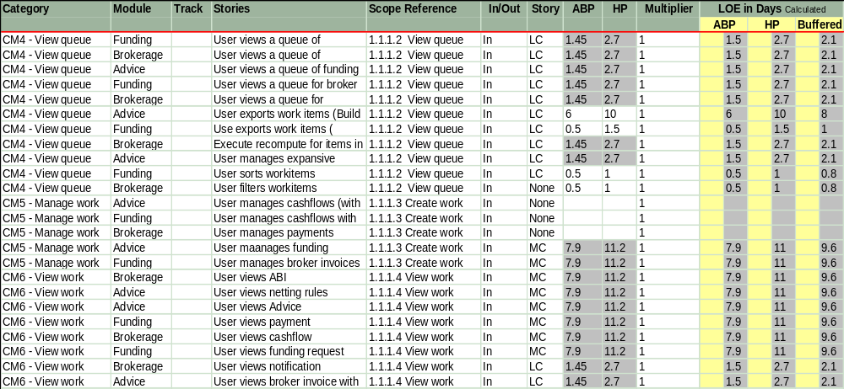
Story LOE Estimates
Notes:
Speaker Notes:
Buffer LOE can be created by ABP and HP by using the formula.
Project’s objective risks buffer is calculated by multiplying team multiplier with Risk Impact and Risk probability.
The only detail required to calculate Total LOE is oversight effort.

Slide 11
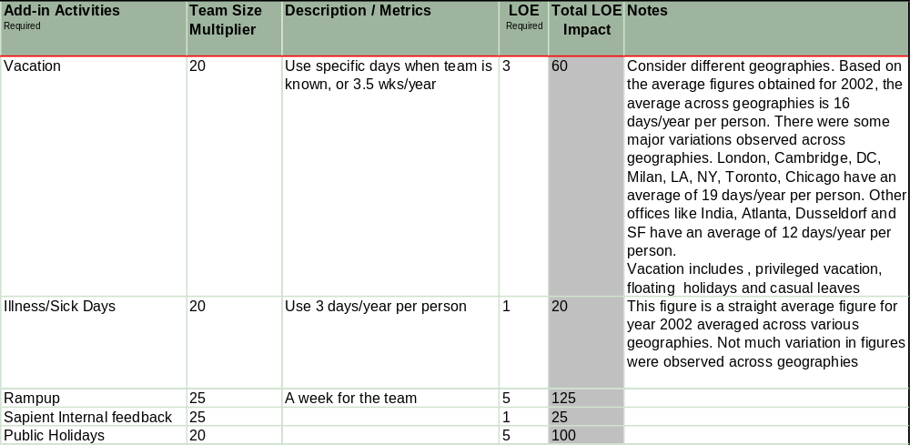
Add Ins
Notes:
Speaker Notes:
Buffer LOE can be created by ABP and HP by using the formula.
Project’s objective risks buffer is calculated by multiplying team multiplier with Risk Impact and Risk probability.
The only detail required to calculate Total LOE is oversight effort.

Slide 12
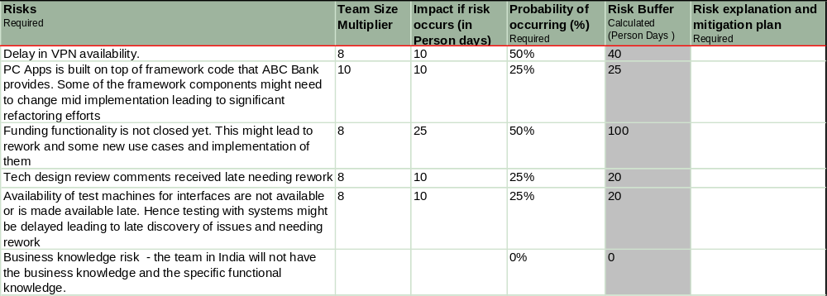
Objective Risks
Notes:
Speaker Notes:
Buffer LOE can be created by ABP and HP by using the formula.
Project’s objective risks buffer is calculated by multiplying team multiplier with Risk Impact and Risk probability.
The only detail required to calculate Total LOE is oversight effort.

Slide 13
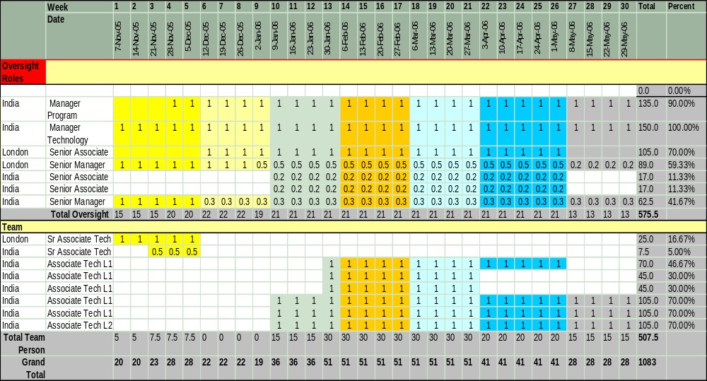
Staffing Plan
Notes:
Speaker Notes:
Buffer LOE can be created by ABP and HP by using the formula.
Project’s objective risks buffer is calculated by multiplying team multiplier with Risk Impact and Risk probability.
The only detail required to calculate Total LOE is oversight effort.

Slide 14
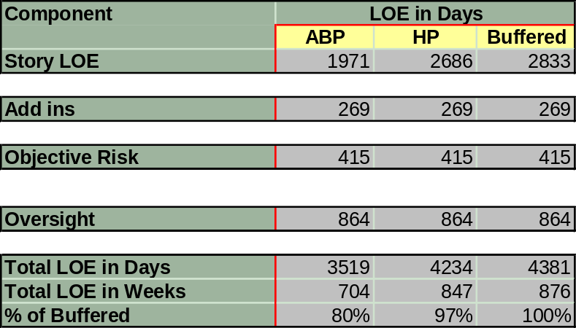
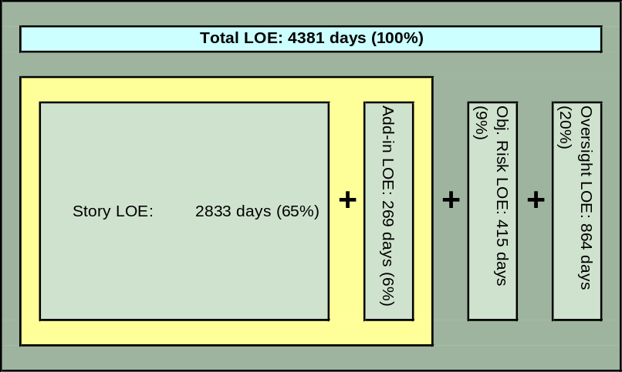
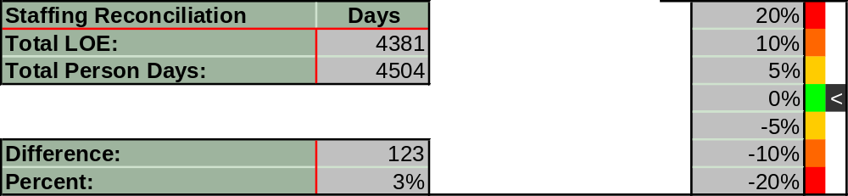
Total LOE
Notes:
Speaker Notes:
Buffer LOE can be created by ABP and HP by using the formula.
Project’s objective risks buffer is calculated by multiplying team multiplier with Risk Impact and Risk probability.
The only detail required to calculate Total LOE is oversight effort.

Slide 15
Estimates for Fusion and Manage Projects
Fusion
  Bottom-up estimates are unusable
  Treat fusion as Time-boxed, fixed capacity engagement
Manage
  Anticipate volume of TARS of various complexities for a given period
  Size the team according to volume of TARs
  Add LOE for “burstable” development capacity for small enhancements
Notes:
Speaker Notes:
Estimation for Fusion and Manage Projects differ from Implementation projects. This slide talks about how FUSION and Manage projects are estimated.

Slide 16

Questions?

